Slide 1

Automatic Detection and Classification of Diabetic Retinopathy Stages in Retinal Image
Presented by:
Md. Abrar Labib (144423)
Saquib Irtiza (144431)
Supervisor:
A. B. M. Ashikur Rahman
Lecturer, IUT

Slide 2
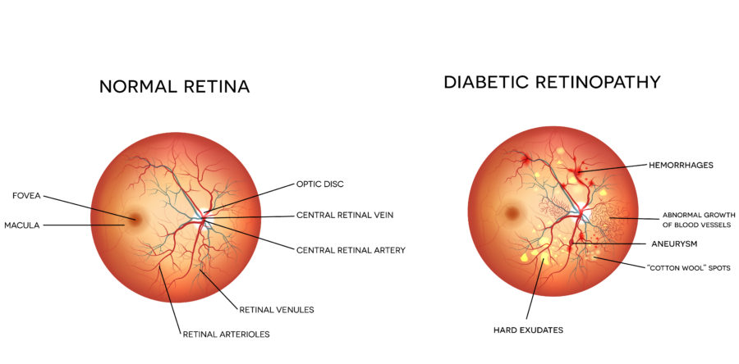
WHAT IS DIABETIC RETINOPATHY?
Disease that causes patients with diabetes to lose eyesight.
Small lesion appears in the retina of the patient’s eye.
It is one of the biggest reasons for blindness.
Ophthalmologists can detect this disease from retinal images.
It can be avoided if detected at an early stage.

Slide 3
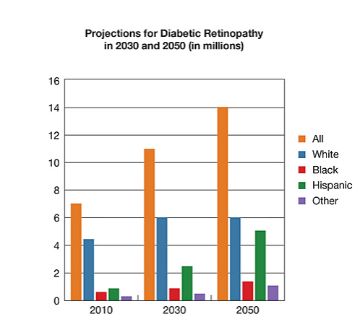
PROBLEM STATEMENT
[1]
Identifying lesions is a complex process.
Takes a lot of time before treatment.
Screening not available in rural areas.
Ophthalmologists often cannot come to a consensus.
Number of patients affected by this disease is rising too fast relative to number of doctors

Slide 4
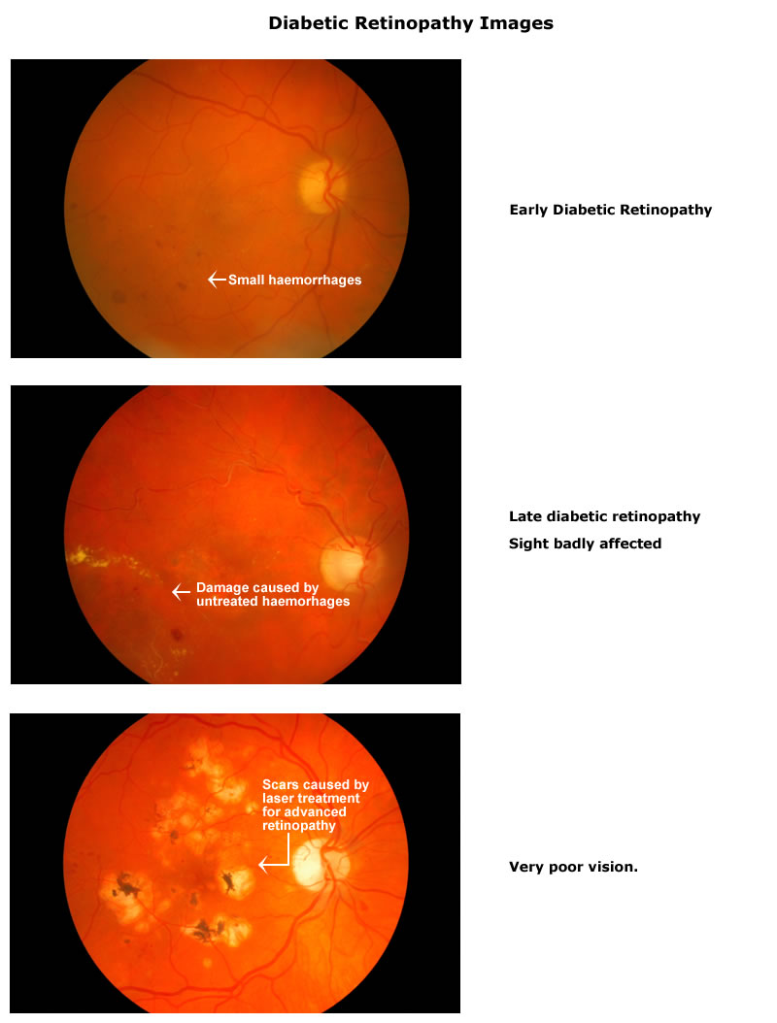
STAGES OF DIABETIC RETINOPATHY
Stage 0: no DR
Stage 1: mild DR
Stage 2: moderate nonproliferative DR
Stage 3: severe nonproliferative DR
Stage 4: proliferative DR or Macular Edema (ME)

Slide 5
AVAILABLE DATASETS
Kaggle[2]: 35,126 labelled colour fundus images from unspecified source
Resolution of images is too high
Some images are cropped
Unbalanced classes
Inconsistent aspect ratio & illumination
Messidor-2[3]: 1,748 labelled colour fundus images from 4 French eye institutions
Benchmark database
Used in many prior studies
Two types of files: .tif and .jpg

Slide 6
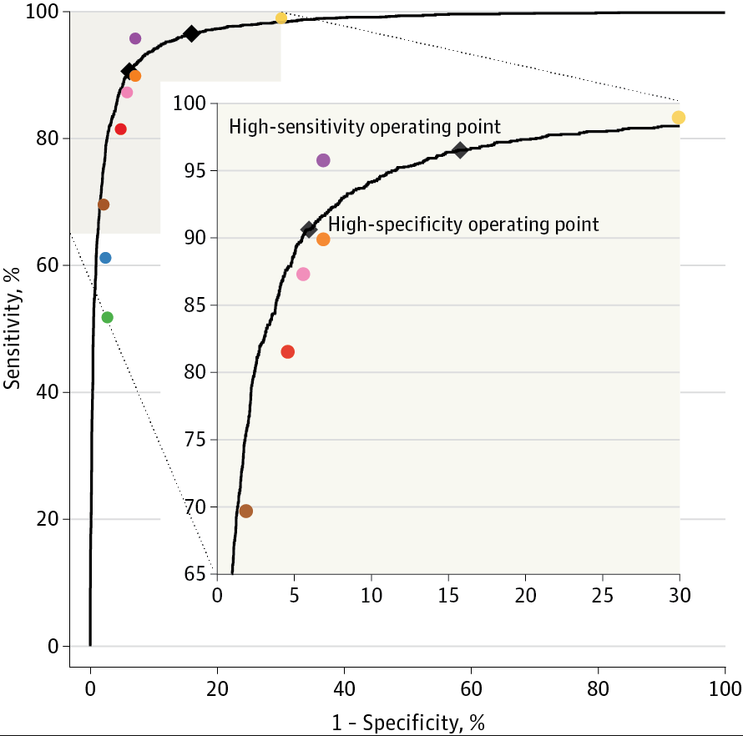
LITERATURE REVIEW
Detection of DR in Retinal Fundus Images[4]:
By Gulshan et al 2016
Dataset:
Algorithm Development Dataset: EyePACS-1 data set (9963 images)
Validation Dataset: Messidor-2 data set (1748 images)
Preprocessing:
Scale normalized by detecting the circular mask of the fundus image.
Resizing the diameter of the fundus to be 299 pixels wide.
Architecture:
Inception-v3 proposed by Szegedy et al. [7]
Optimization algorithm:
Distributed stochastic gradient descent implementation by Dean et al. [8]
Area under the curve: 97.4%.

Slide 7
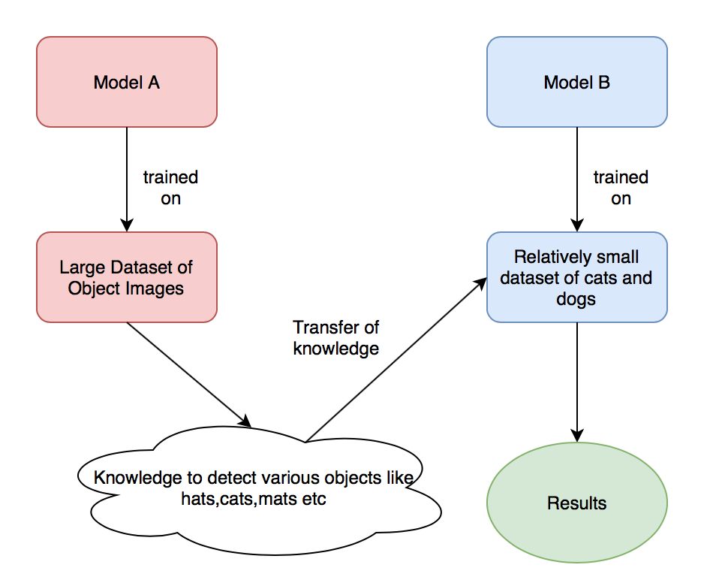
TRANSFER LEARNING
Storing knowledge gained when solving one problem and applying it to a different, but related problem[5].
A model developed for one task is re-used as the starting point for a different task.

Slide 8
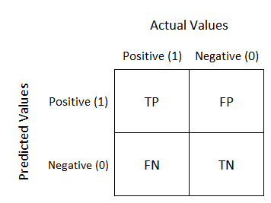
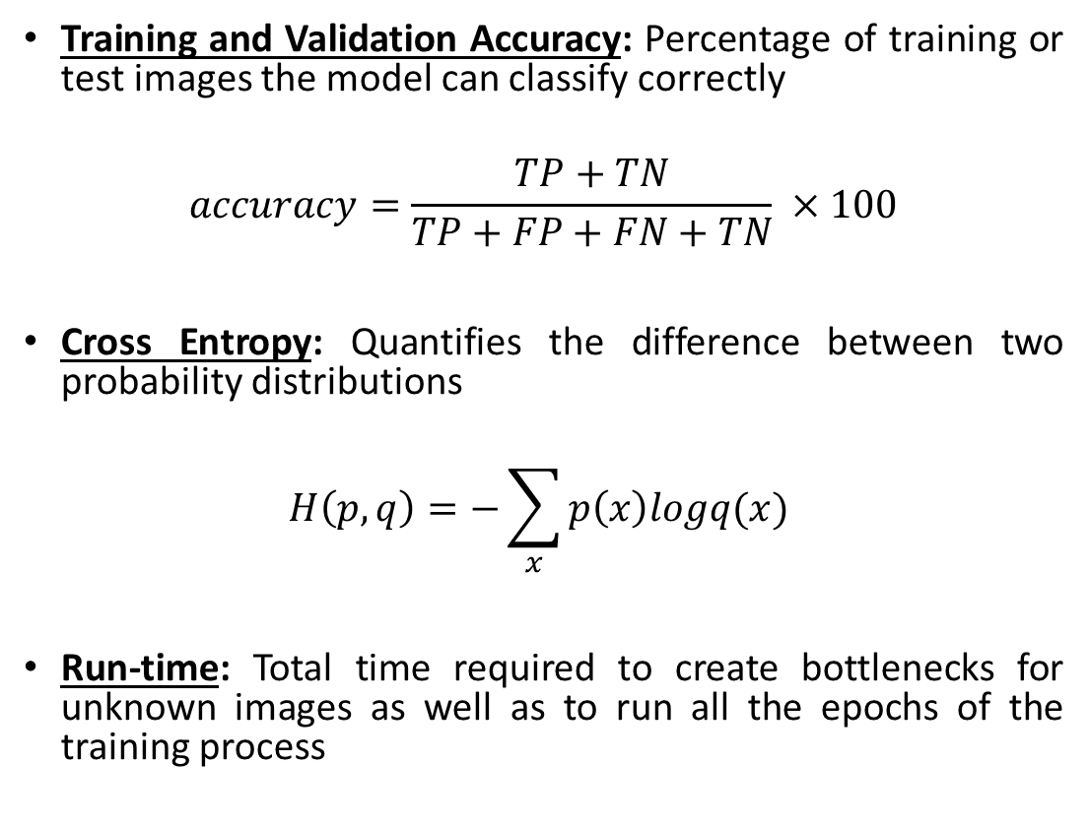
EVALUATION METHODS
Training and Validation Accuracy: Percentage of training or test images the model can classify correctly
$$accuracy=\frac{TP+TN}{TP+FP+FN+TN} ×100$$
Cross Entropy: Quantifies the difference between two probability distributions
$$H\left(p, q\right)=−\sum_{x}{p\left(x\right)logq(x)}$$
Run-time: Total time required to create bottlenecks for unknown images as well as to run all the epochs of the training process

Slide 9
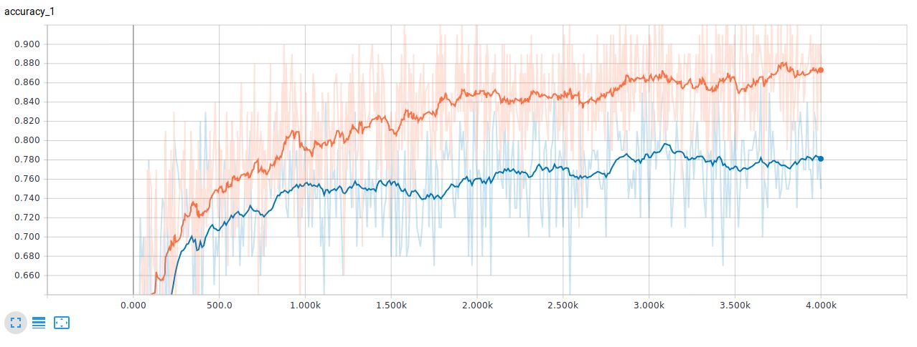
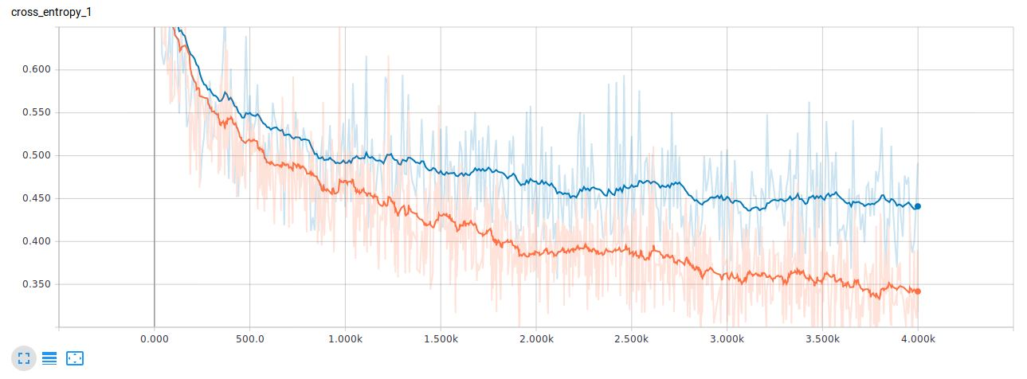
PERFORMANCE METRIC VARIATION
Validation (blue) and Training (orange) Accuracy
Cross Entropy

Slide 10
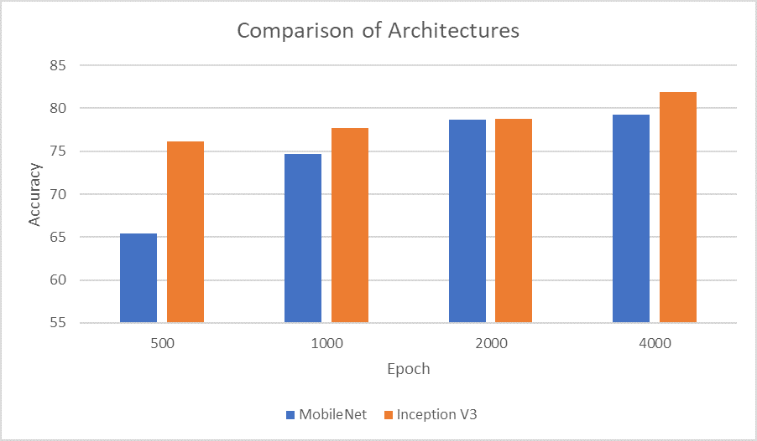
ARCHITECTURE COMPARISON
Epochs/Architecture | MobileNet [10] | Inception V3 [9]
500 | 65.4% | 76.1%
1000 | 74.7% | 77.7%
2000 | 78.7% | 78.8%
4000 | 79.3% | 81.9%

Slide 11
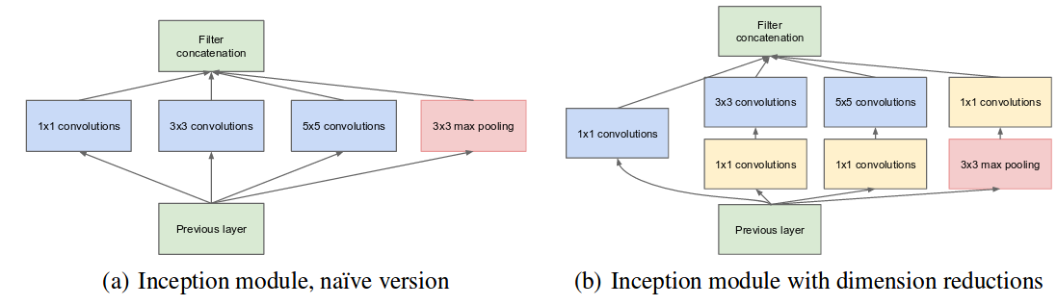
INCEPTION MODULE

Slide 12
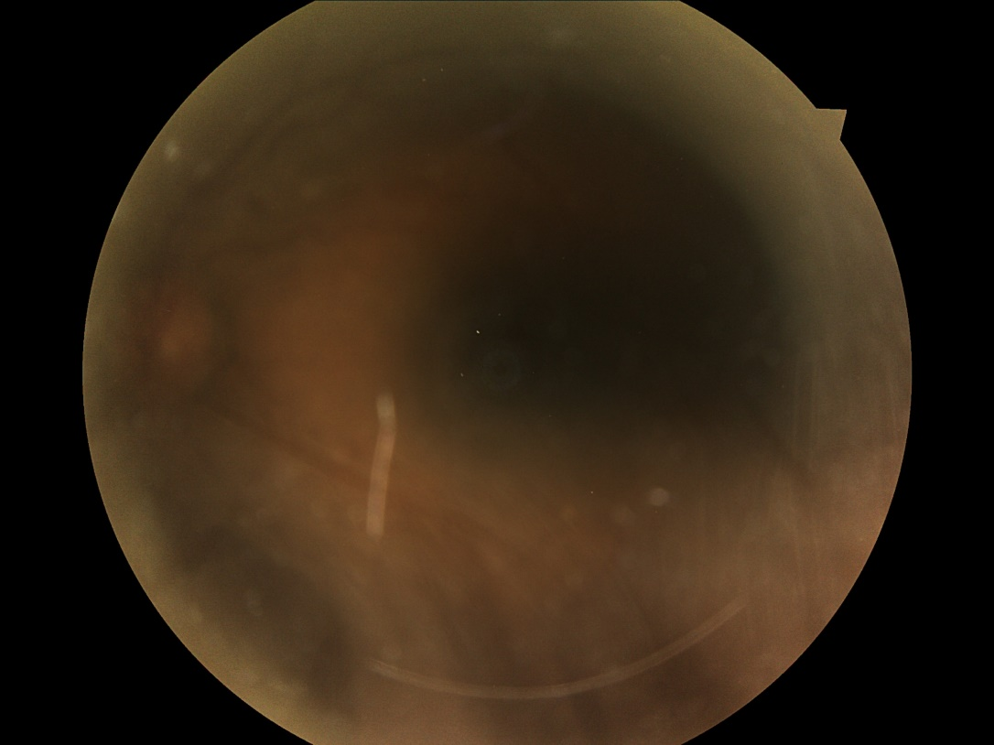
DATASET COMPARISON
Datasets/Epochs | 500 | 1000 | 2000 | 4000
Kaggle | 55.7% | 57.1% | 58.8% | 60.1%
Messidor-2 | 76.1% | 77.7% | 78.8% | 81.9%
Undesirable image

Slide 13
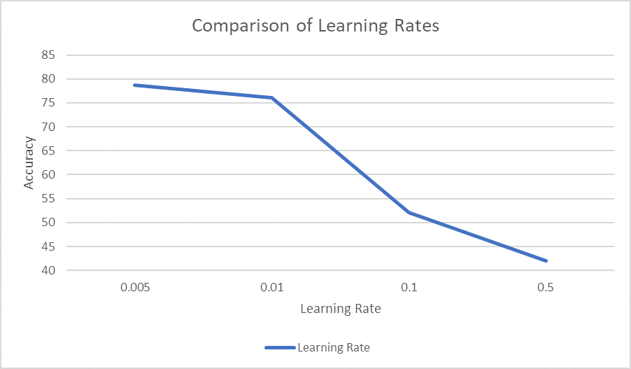
PARAMETER OPTIMIZATION
Learning Rate | Accuracy
0.005 | 78.7%
0.01 | 76.1%
0.1 | 52.1%
0.5 | 42%

Slide 14
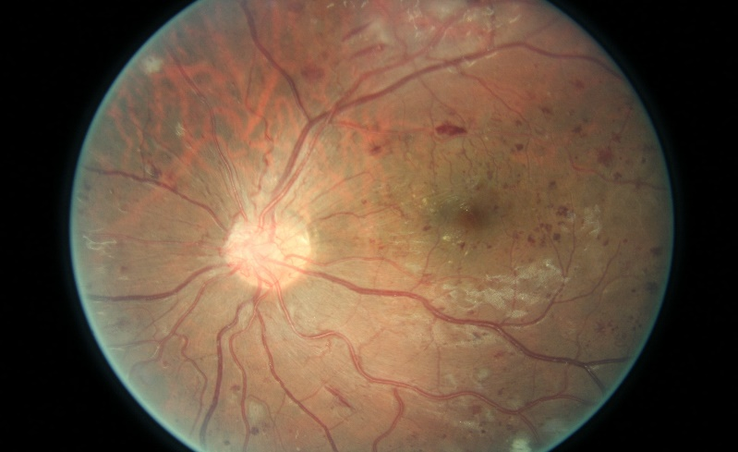
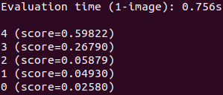
TEST IMAGE CLASSIFICATION
Retrained Module
Put For Test
Test Image
Output

Slide 15
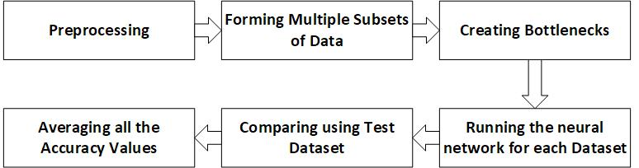
PROPOSED METHOD
Bottlenecks: Features that are made to train the last step of the pre-trained model. It reduces the access time during the training period

Slide 16

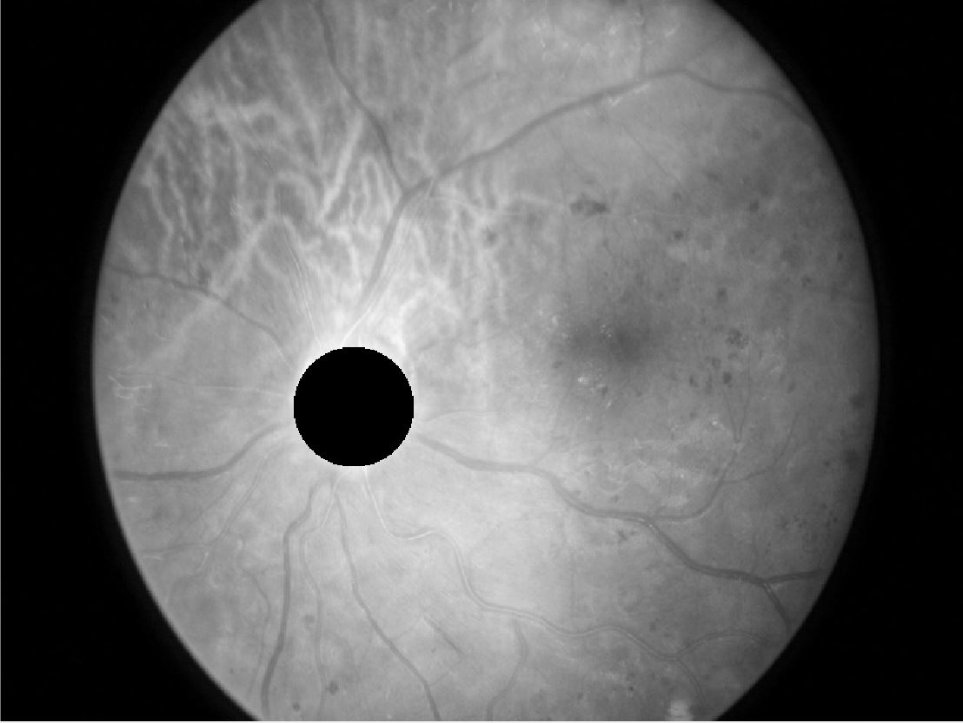
PRE-PROCESSING
Images were resized to reduce complexity
Red channel is extracted from RGB image
Optic disc was removed to eliminate confusing objects

Slide 17
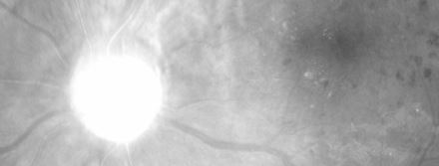
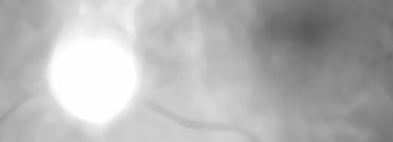
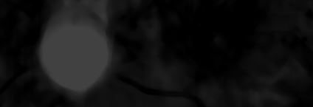
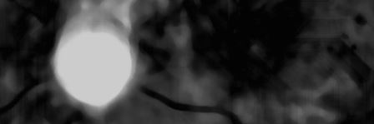


PRE-PROCESSING STEPS
Replicated from Saleh et al. 2012[6]
Red Channel Gray Image
Applying Median Filter
Using Top-Hat Filter
Contrast Stretching
Binary Image
Morphological Opening & Closing

Slide 18
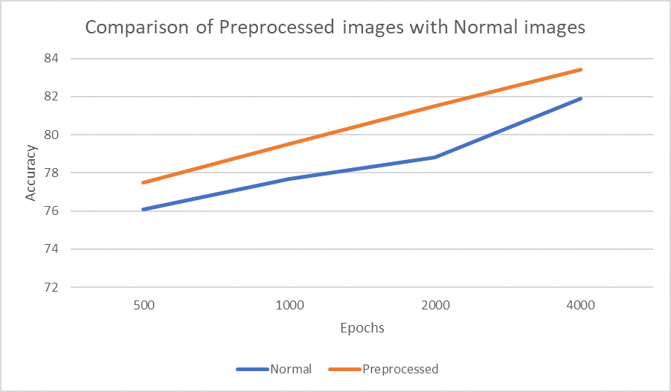
PERFORMANCE EVALUATION
Epochs/ Dataset | Normal | Pre-processed
500 | 76.1% | 77.5%
1000 | 77.7% | 79.5%
2000 | 78.8% | 81.5%
4000 | 81.9% | 83.4%

Slide 19
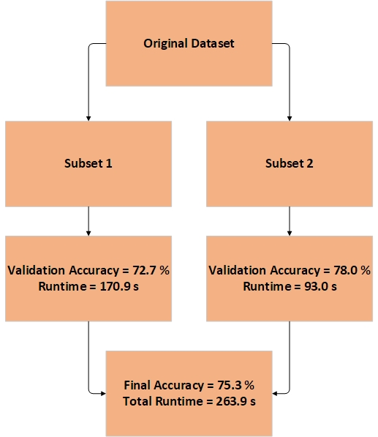
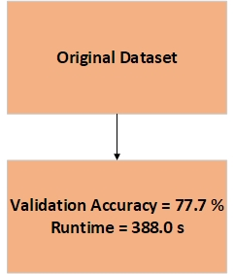
RUN-TIME EVALUATION

Slide 20
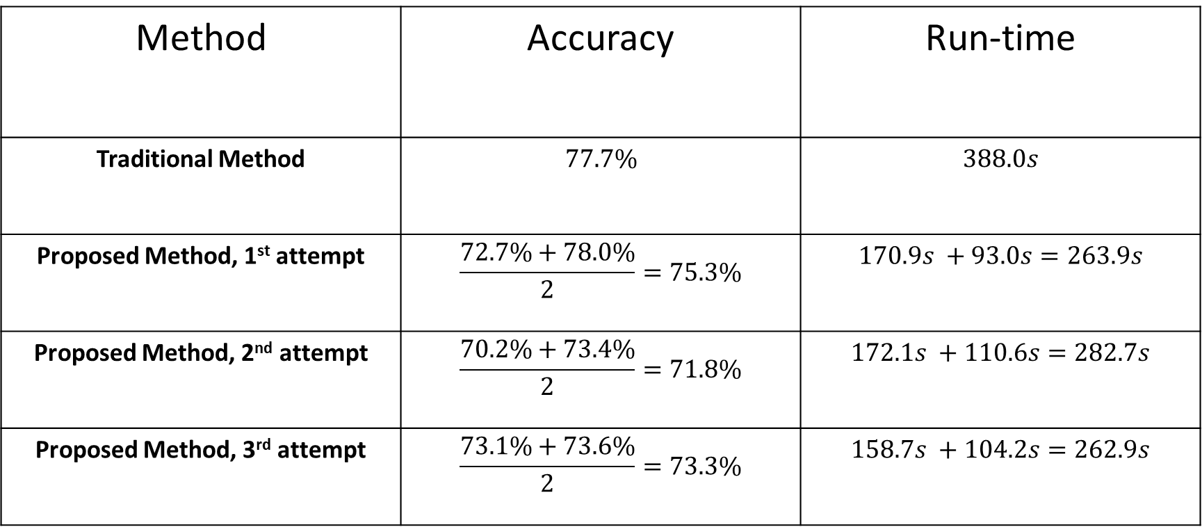
RUN-TIME EVALUATION
Method | Accuracy | Run-time
Traditional Method | $$77.7\%$$ | $$388.0s$$
Proposed Method, 1st attempt | $$\frac{72.7\%+78.0\%}{2}=75.3\%$$ | $$170.9s +93.0s=263.9s$$
Proposed Method, 2nd attempt | $$\frac{70.2\%+73.4\%}{2}=71.8\%$$ | $$172.1s +110.6s=282.7s$$
Proposed Method, 3rd attempt | $$\frac{73.1\%+73.6\%}{2}=73.3\%$$ | $$158.7s +104.2s=262.9s$$

Slide 21
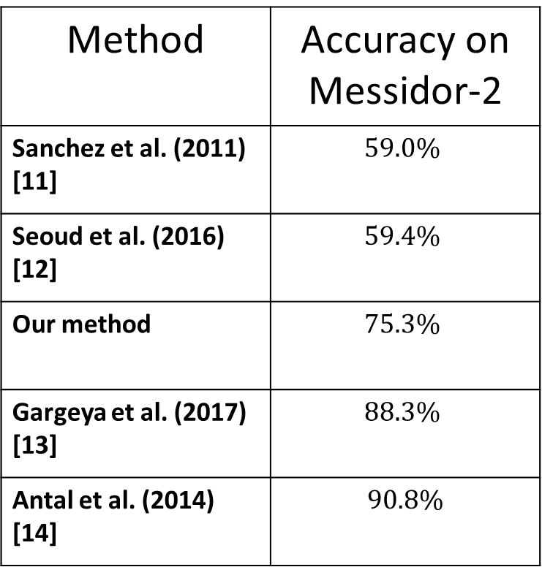
COMPARATIVE ANALYSIS
Method | Accuracy on Messidor-2
Sanchez et al. (2011) [11] | $$59.0\%$$
Seoud et al. (2016) [12] | $$59.4\%$$
Our method | $$75.3\%$$
Gargeya et al. (2017) [13] | $$88.3\%$$
Antal et al. (2014) [14] | $$90.8\%$$

Slide 22
LIMITATIONS
Run-time minimizations may not be maintained for large datasets.
Inconsistencies in images such as illumination, resolution affect pre-processing results.
Random sub-setting of the dataset sometimes produces anomalous results
Datasets are formed using special medical equipment which may not be found locally.
Photos of injured eyes cannot be classified correctly.

Slide 23
FUTURE WORK
Train the model from scratch or with a large dataset.
Try different models such as RNN, Inception V4, ResNet, VGG.
Try an ensemble method by combining the results from multiple models.
Augment the dataset to balance the categories and also prevent overfitting.
Perform segmentation to identify region of interest before feeding into network.
Instead of halving the dataset, train with subsets of variable length to see how the run-time to-accuracy ratio is affected.

Slide 24
REFERENCES
“National Eye Institute (NEI): Diabetic Retinopathy”, accessed: 2018-07-02. [Online]. Available: https://nei.nih.gov/eyedata/diabetic.
“Kaggle datasets: Diabetic retinopathy detection,” accessed: 2016-10-05. [Online]. Available: https://www.kaggle.com/c/diabetic-retinopathy-detection/data.
E. Decencire, X. Zhang, G. Cazuguel, B. Lay, B. Cochener, C. Trone, P. Gain, R. Ordonez, P. Massin, A. Erginay, B. Charton, and J.-C. Klein, “Feedback on a publicly distributed database: the messidor database,” Image Analysis & Stereology, vol. 33, no. 3, pp. 231–234, Aug. 2014. [Online]. Available: http://www.ias-iss.org/ojs/IAS/article/view/1155.
V. Gulshan, L. Peng, M. Coram, M. C. Stumpe, D. Wu, A. Narayanaswamy, S. Venugopalan, K. Widner, T. Madams, J. Cuadros et al., “Development and validation of a deep learning algorithm for detection of diabetic retinopathy in retinal fundus photographs,” Jama, vol. 316, no. 22, pp. 2402–2410, 2016.
“Transfer learning definition,” accessed: 2018-10-13. [Online]. Available: https://towardsdatascience.com/transfer-learning-using-differentiallearning-rates-638455797f00.
Saleh, Marwan D., and Chikkannan Eswaran. "An automated decision-support system for non-proliferative diabetic retinopathy disease based on MAs and HAs detection." Computer methods and programs in biomedicine 108, no. 1 (2012): 186-196.
Szegedy, Christian, et al. "Going deeper with convolutions." Proceedings of the IEEE conference on computer vision and pattern recognition. 2015.
Dean, Jeffrey, et al. "Large scale distributed deep networks." Advances in neural information processing systems. 2012.
C. Szegedy, W. Liu, Y. Jia, P. Sermanet, S. E. Reed, D. Anguelov, D. Erhan, V. Vanhoucke, and A. Rabinovich, “Going deeper with convolutions,” CoRR, vol. abs/1409.4842, 2014. [Online]. Available: http://arxiv.org/abs/1409.4842.
A. G. Howard, M. Zhu, B. Chen, D. Kalenichenko, W. Wang, T. Weyand, M. Andreetto, and H. Adam, “Mobilenets: Efficient convolutional neural networks for mobile vision applications,” CoRR, vol. abs/1704.04861, 2017. [Online]. Available: http://arxiv.org/abs/1704.04861.
Sánchez, Clara I., Meindert Niemeijer, Alina V. Dumitrescu, Maria SA Suttorp-Schulten, Michael D. Abramoff, and Bram van Ginneken. "Evaluation of a computer-aided diagnosis system for diabetic retinopathy screening on public data." Investigative ophthalmology & visual science 52, no. 7 (2011): 4866-4871.
Seoud, Lama, Thomas Hurtut, Jihed Chelbi, Farida Cheriet, and JM Pierre Langlois. "Red lesion detection using dynamic shape features for diabetic retinopathy screening." IEEE transactions on medical imaging 35, no. 4 (2016): 1116-1126.
R. Gargeya and T. Leng, “Automated identification of diabetic retinopathy using deep learning,” Ophthalmology, vol. 124, no. 7, pp. 962–969, 2017.
Antal, Bálint, and András Hajdu. "An ensemble-based system for automatic screening of diabetic retinopathy." Knowledge-based systems 60 (2014): 20-27.

